Slide 1
Day 17
Using Dogs as a Model
Notes:
K-3 STEM Foundations
Field Test Version: Do not distribute, photocopy or forward this document for use at other locations.
Day 17: Butterfly Offspring
Keywords
lesson, gene, dominant gene, recessive gene, genotype, phenotype, Shelties, model organism
K-3 STEM Foundations: Day 17: Using Dogs as a Model © Baylor College of Medicine.

Slide 2
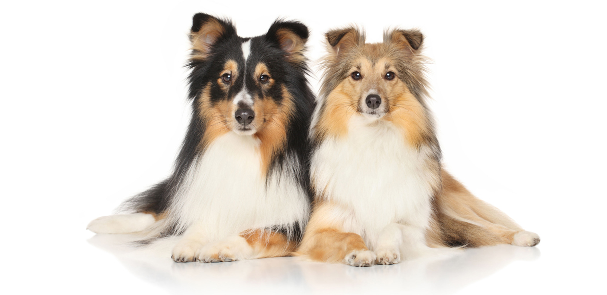
Adult Male
Trait | Phenotype
Paw fur color | WHITE
Number of legs | FOUR
Snout color | WHITE & BROWN
Coat color | BLACK
Chest fur color | WHITE
Adult Female
Trait | Phenotype
Paw fur color | WHITE
Number of legs | FOUR
Snout color | brown
Coat color | brown
Chest fur color | WHITE
Notes:
K-3 STEM Foundations
Field Test Version: Do not distribute, photocopy or forward this document for use at other locations.
Day 17: Butterfly Offspring
Keywords
lesson, gene, dominant gene, recessive gene, genotype, phenotype, Shelties, model organism
K-3 STEM Foundations: Day 17: Using Dogs as a Model © Baylor College of Medicine.

Slide 3
Adult Male
Trait | Phenotype
Paw fur color | WHITE
Number of legs | FOUR
Snout color | WHITE & BROWN
Coat color | BLACK
Chest fur color | WHITE
Offspring
Trait | Phenotype
Paw fur color
Number of legs
Snout color
Coat color
Chest fur color
Adult Female
Trait | Phenotype
Paw fur color | WHITE
Number of legs | FOUR
Snout color | brown
Coat color | brown
Chest fur color | WHITE
Notes:
K-3 STEM Foundations
Field Test Version: Do not distribute, photocopy or forward this document for use at other locations.
Day 17: Butterfly Offspring
Keywords
lesson, gene, dominant gene, recessive gene, genotype, phenotype, Shelties, model organism
K-3 STEM Foundations: Day 17: Using Dogs as a Model © Baylor College of Medicine.

Slide 4
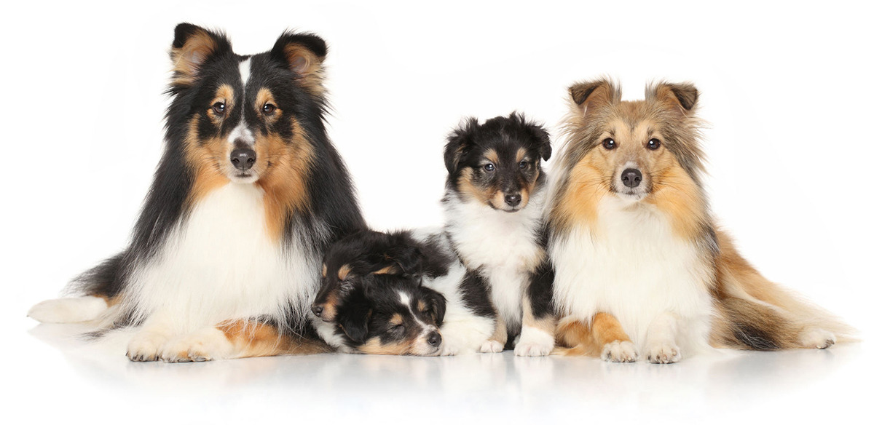
Adult Male
Trait | Phenotype
Paw fur color | WHITE
Number of legs | FOUR
Snout color | WHITE & BROWN
Coat color | BLACK
Chest fur color | WHITE
Offspring
Trait | Phenotype
Paw fur color | WHITE
Number of legs | FOUR
Snout color | WHITE BROWN
Coat color | BLACK
Chest fur color | WHITE
Adult Female
Trait | Phenotype
Paw fur color | WHITE
Number of legs | FOUR
Snout color | brown
Coat color | brown
Chest fur color | WHITE
Notes:
K-3 STEM Foundations
Field Test Version: Do not distribute, photocopy or forward this document for use at other locations.
Day 17: Butterfly Offspring
Keywords
lesson, gene, dominant gene, recessive gene, genotype, phenotype, Shelties, model organism
K-3 STEM Foundations: Day 17: Using Dogs as a Model © Baylor College of Medicine.

