Slide 1
Day 14
Butterfly Offspring
Notes:
K-3 STEM Foundations
Field Test Version: Do not distribute, photocopy or forward this document for use at other locations.
Day 14: Inherited Butterfly Wing Characteristics
Teacher Notes
Keywords
lesson, animal, butterfly, Heliconius, family, offspring, parent, characteristic, trait, gene
K-3 STEM Foundations. Day 14: Butterfly Offspring © Baylor College of Medicine.

Slide 2
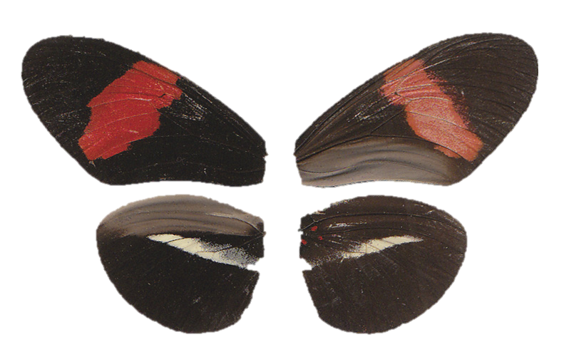
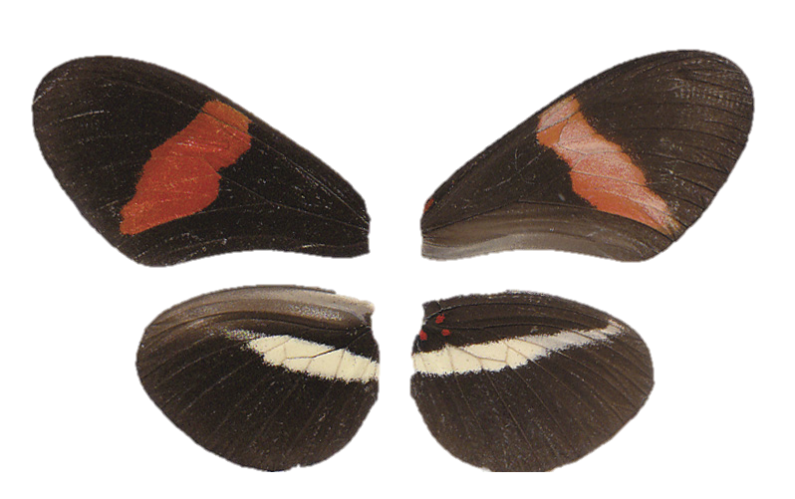
Heliconius Butterflies
Male
Female
Notes:
K-3 STEM Foundations
Field Test Version: Do not distribute, photocopy or forward this document for use at other locations.
Teacher Notes
Compare the male and female butterflies with students (shown above).
Image Reference
Maroja LS, Alschuler R, McMillan WO, Jiggins CD (2012) Partial Complementarity of the Mimetic Yellow Bar Phenotype in Heliconius Butterflies. PLoS ONE 7(10): e48627. doi:10.1371/journal.pone.0048627
Received July 16, 2012; Accepted October 1, 2012; Published October 31, 2012.
Copyright © 2012 Maroja, et al. This is an open-access article distributed under the terms of the Creative Commons Attribution License, which permits unrestricted use, distribution, and reproduction in any medium, provided the original author and source are credited.
Keywords
lesson, animal, butterfly, Heliconius, family, offspring, parent, characteristic, trait, gene
K-3 STEM Foundations. Day 14: Butterfly Offspring © Baylor College of Medicine.

Slide 3
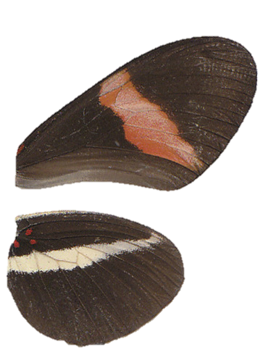
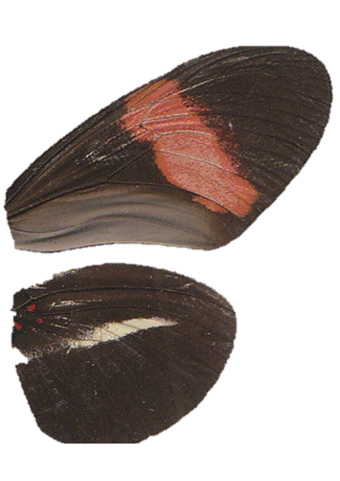
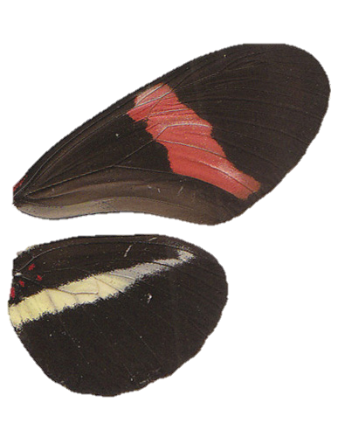
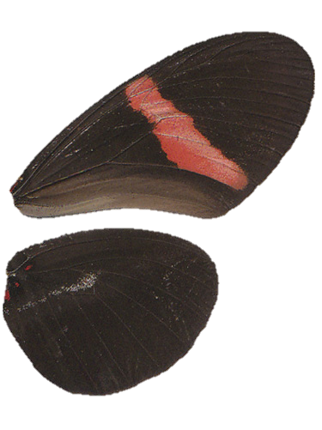
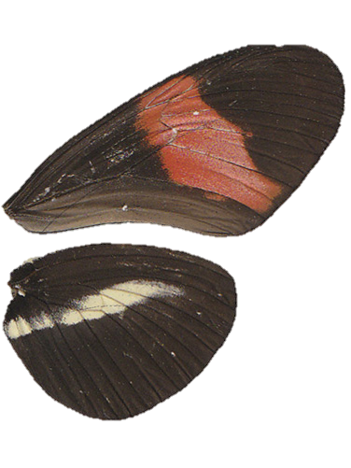
Observing Wing Patterns
Notes:
K-3 STEM Foundations
Field Test Version: Do not distribute, photocopy or forward this document for use at other locations.
Day 14: Inherited Butterfly Wing Characteristics
Teacher Notes
Before handing out print copies for students to observe, talk about what they can compare, such as stripe colors and width, wing shape, where the stripes appear, etc.
Image Reference
Maroja LS, Alschuler R, McMillan WO, Jiggins CD (2012) Partial Complementarity of the Mimetic Yellow Bar Phenotype in Heliconius Butterflies. PLoS ONE 7(10): e48627. doi:10.1371/journal.pone.0048627
Received July 16, 2012; Accepted October 1, 2012; Published October 31, 2012.
Copyright © 2012 Maroja, et al. This is an open-access article distributed under the terms of the Creative Commons Attribution License, which permits unrestricted use, distribution, and reproduction in any medium, provided the original author and source are credited.
Keywords
lesson, animal, butterfly, Heliconius, family, offspring, parent, characteristic, trait, gene
K-3 STEM Foundations. Day 14: Butterfly Offspring © Baylor College of Medicine.

