Slide 1
Day 14
Butterflies of South America
Notes:
K-3 STEM Foundations
Field Test Version: Do not distribute, photocopy or forward this document for use at other locations.
Day 14: Inherited Butterfly Wing Characteristics
K-3 STEM Foundations. Day 14: Butterflies of South America © Baylor College of Medicine.

Slide 2




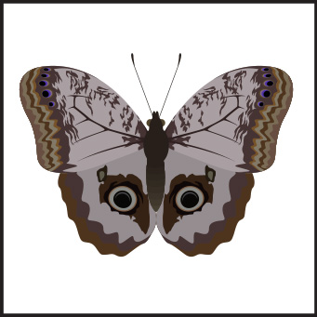







Notes:
K-3 STEM Foundations
Field Test Version: Do not distribute, photocopy or forward this document for use at other locations.
Day 14: Inherited Butterfly Wing Characteristics
Teacher Notes
Illustrations shown above are butterflies from South America.
Image Reference
Illustrations © Skellos. Licensed for use.
K-3 STEM Foundations. Day 14: Butterflies of South America © Baylor College of Medicine.

