Slide 1
Day 10
Be A Citizen Scientist
Notes:
K-3 STEM Foundations
Field Test Version: Do not distribute, photocopy or forward this document for use at other locations.
Day 10: Be a Citizen Scientist
Teacher Notes
K-3 STEM Foundations. Day 10: Be A Citizen Scientist © Baylor College of Medicine.

Slide 2
Monika Maeckle, Citizen Scientist
Monika Maeckle is a citizen scientist.
She loves the monarch butterfly.
Monika Maeckle
Notes:
K-3 STEM Foundations
Field Test Version: Do not distribute, photocopy or forward this document for use at other locations.
Day 10: Be a Citizen Scientist
Teacher Notes
Image Reference
https://texasbutterflyranch.com/
K-3 STEM Foundations. Day 10: Be A Citizen Scientist © Baylor College of Medicine.

Slide 3
Monika Maeckle, Citizen Scientist
As a child, Monika liked to explore the creek where she lived.
She liked to plant gardens with her parents.
Mammoth Sunflower seed head provides dozens of places for adult monarchs to feed.
Notes:
K-3 STEM Foundations
Field Test Version: Do not distribute, photocopy or forward this document for use at other locations.
Day 10: Be a Citizen Scientist
Teacher Notes
Image Reference
https://texasbutterflyranch.com/
K-3 STEM Foundations. Day 10: Be A Citizen Scientist © Baylor College of Medicine.

Slide 4
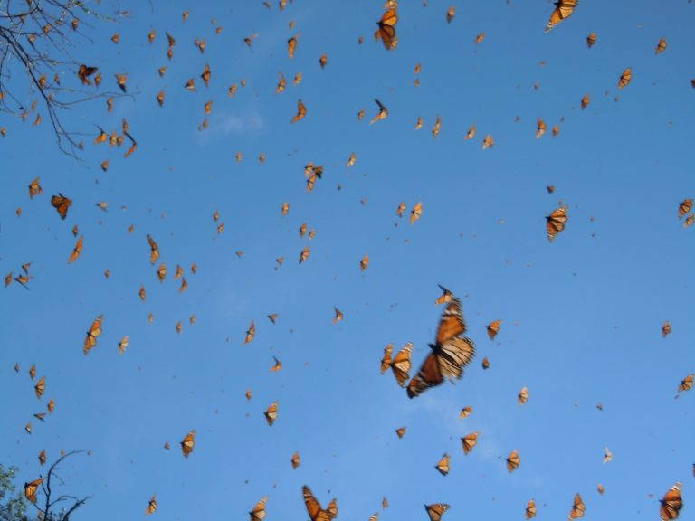
Monika Maeckle, Citizen Scientist
As she got older, she observed that pecan trees on the banks of the Llano river provided a roosting place for thousands of monarchs.
Each fall, the monarchs migrate to Mexico.
Migrating monarchs
Notes:
K-3 STEM Foundations
Field Test Version: Do not distribute, photocopy or forward this document for use at other locations.
Day 10: Be a Citizen Scientist
Teacher Notes
Image Reference
https://texasbutterflyranch.com/
K-3 STEM Foundations. Day 10: Be A Citizen Scientist © Baylor College of Medicine.

Slide 5
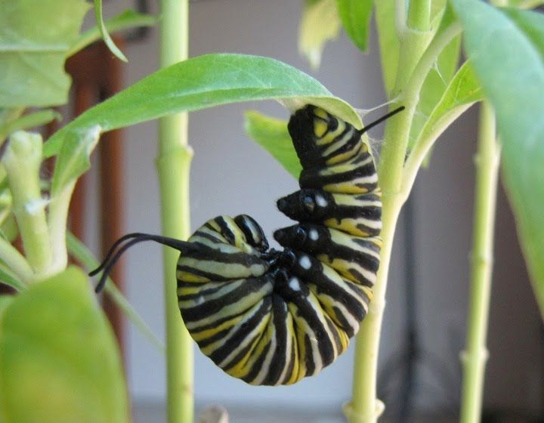
Monika Maeckle, Citizen Scientist
Monika began studying the monarchs.
She has a ranch devoted to protecting butterflies. It is called the Texas Butterfly Ranch.
Monarch caterpillar (larva)
Notes:
K-3 STEM Foundations
Field Test Version: Do not distribute, photocopy or forward this document for use at other locations.
Day 10: Be a Citizen Scientist
Teacher Notes
Image Reference
https://texasbutterflyranch.com/
K-3 STEM Foundations. Day 10: Be A Citizen Scientist © Baylor College of Medicine.

Slide 6
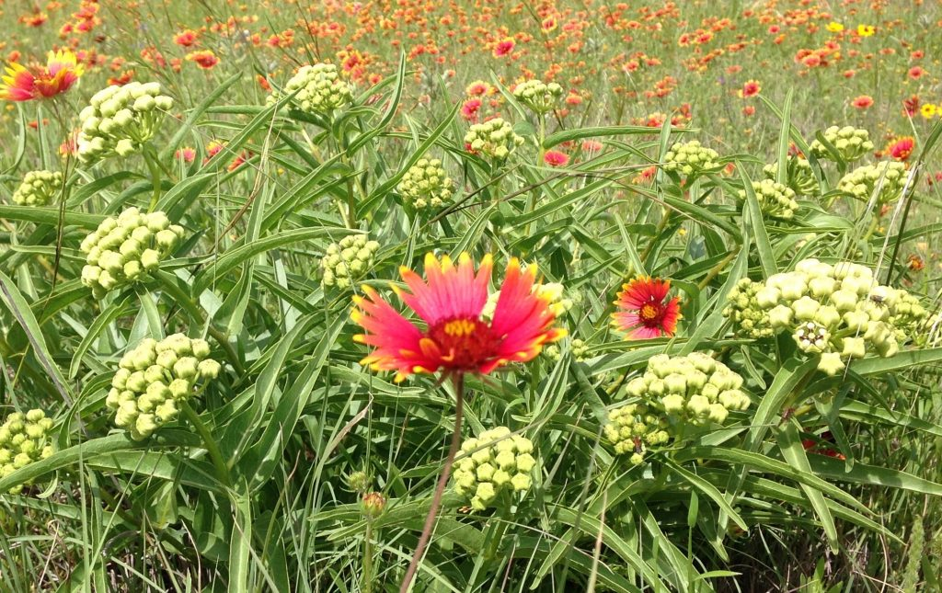
Monika Maeckle, Citizen Scientist
Monika teaches people how to plant butterfly gardens.
She places small tags on monarch wings. The tags permit scientists to follow monarch migration.
Butterfly garden
Notes:
K-3 STEM Foundations
Field Test Version: Do not distribute, photocopy or forward this document for use at other locations.
Day 10: Be a Citizen Scientist
Teacher Notes
Image Reference
https://texasbutterflyranch.com/
K-3 STEM Foundations. Day 10: Be A Citizen Scientist © Baylor College of Medicine.

Slide 7
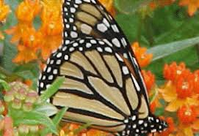
Monika Maeckle, Citizen Scientist
Monika explores the butterfly life cycle and educates others about the wonder of butterflies.
Monika Maeckle is a citizen scientist.
Monarch butterfly
Notes:
K-3 STEM Foundations
Field Test Version: Do not distribute, photocopy or forward this document for use at other locations.
Day 10: Be a Citizen Scientist
Teacher Notes
Image Reference
https://texasbutterflyranch.com/
K-3 STEM Foundations. Day 10: Be A Citizen Scientist © Baylor College of Medicine.

Slide 8
Turn and Talk
What do you think a citizen scientist is? What do they do?
Monika Maeckle was inspired by seeing thousands of monarchs. What inspires you?
Can you be a citizen scientist?
Notes:
K-3 STEM Foundations
Field Test Version: Do not distribute, photocopy or forward this document for use at other locations.
Day 10: Be a Citizen Scientist
Teacher Notes
K-3 STEM Foundations. Day 10: Be A Citizen Scientist © Baylor College of Medicine.

