Slide 1
Day 8
A Butterfly
Notes:
K-3 STEM Foundations
Field Test Version: Do not distribute, photocopy or forward this document for use at other locations.
Day 8: Scientific Illustration
Note(s)
This slide is left purposely blank so that students will not see the first slide containing images until you are ready to project it. See Day 8, “Procedure,” for complete instructions on how to use this slide set.
K-3 STEM Foundations. Day 8: A Butterfly © Baylor College of Medicine.

Slide 2
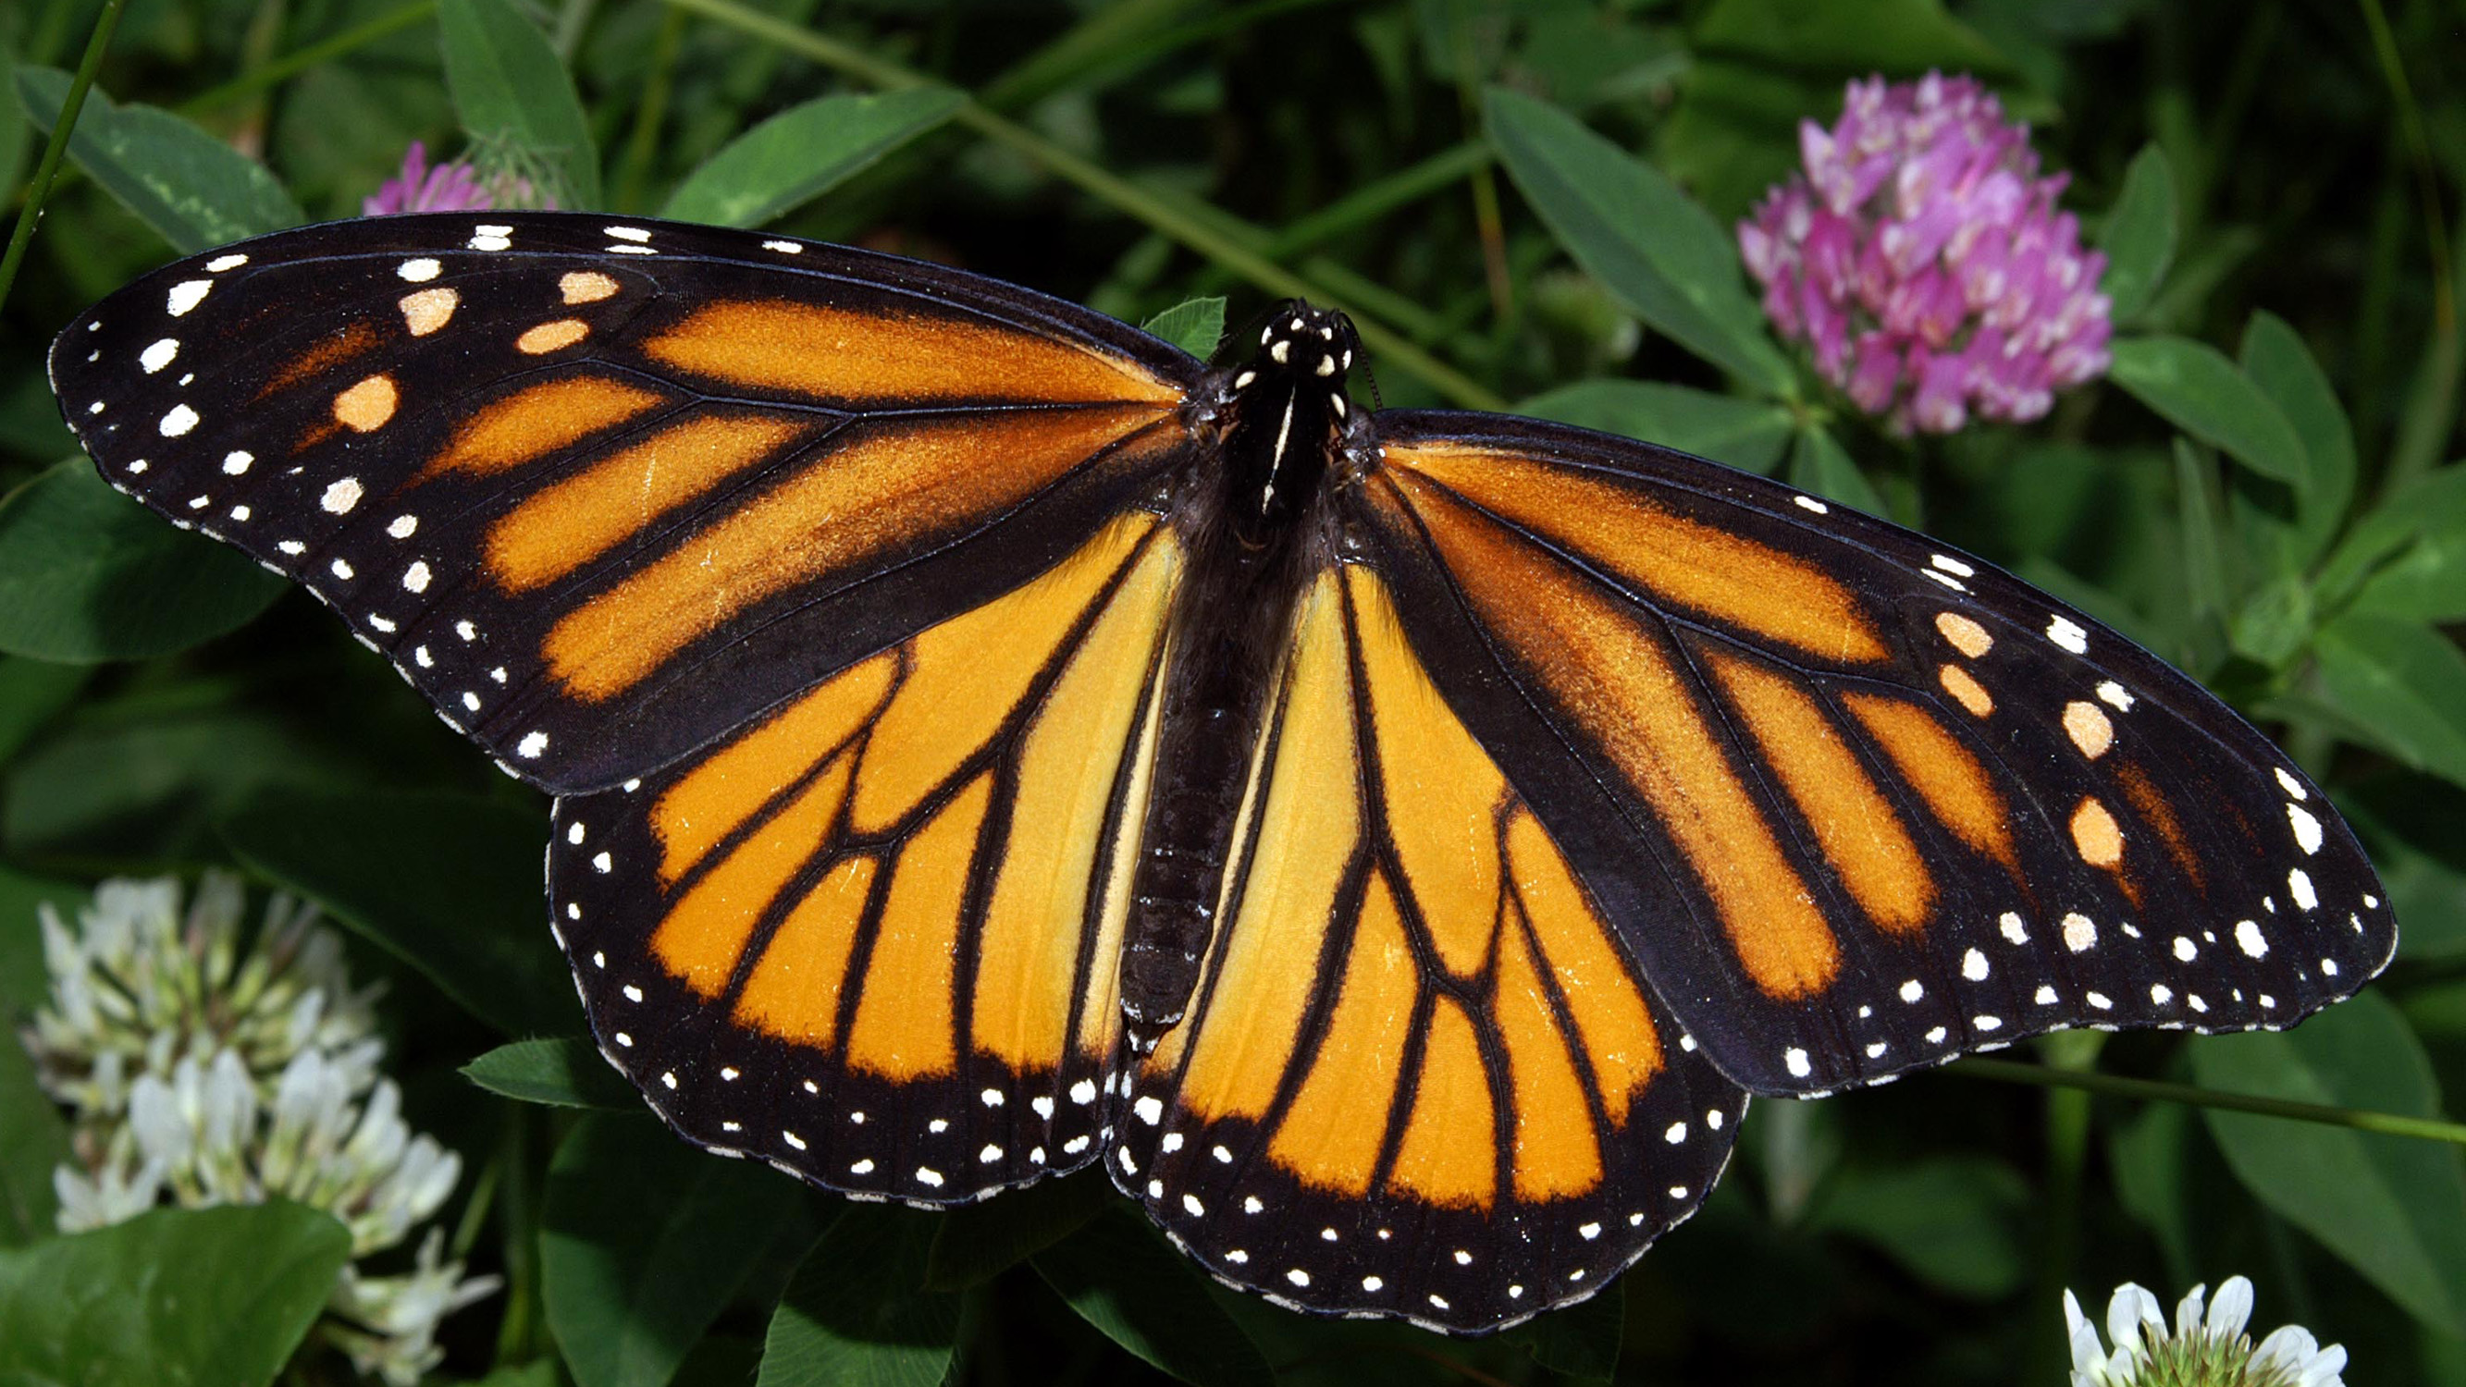
Notes:
K-3 STEM Foundations
Field Test Version: Do not distribute, photocopy or forward this document for use at other locations.
Day 8: Scientific Illustration
Image Reference
Monarch butterfly (Danaus plexippus) © Kenneth Dwain Harrelson. May 29, 2007. CC-BY-SA 3.0. https://commons.wikimedia.org/wiki/File:Monarch_In_May
K-3 STEM Foundations. Day 8: A Butterfly © Baylor College of Medicine.

Slide 3
Notes:
K-3 STEM Foundations
Field Test Version: Do not distribute, photocopy or forward this document for use at other locations.
Day 8: Scientific Illustration
Note(s)
This slide is left purposely blank so that students will not see the first slide containing the image until you are ready to project it (see “Procedure”).
K-3 STEM Foundations. Day 8: A Butterfly © Baylor College of Medicine.

