Slide 1
Day 1
Memory Pictures
Notes:
K-3 STEM Foundations
Field Test Version: Do not distribute, photocopy or forward this document for use at other locations.
Day 1: Team Building for Scientific Research
Note(s)
This slide is left purposely blank so that students will not see the first slide containing images until you are ready to project it. See Day 1, “Procedure,” for full instructions.
K-3 STEM Foundations. Day 1. Memory Pictures © Baylor College of Medicine.

Slide 2
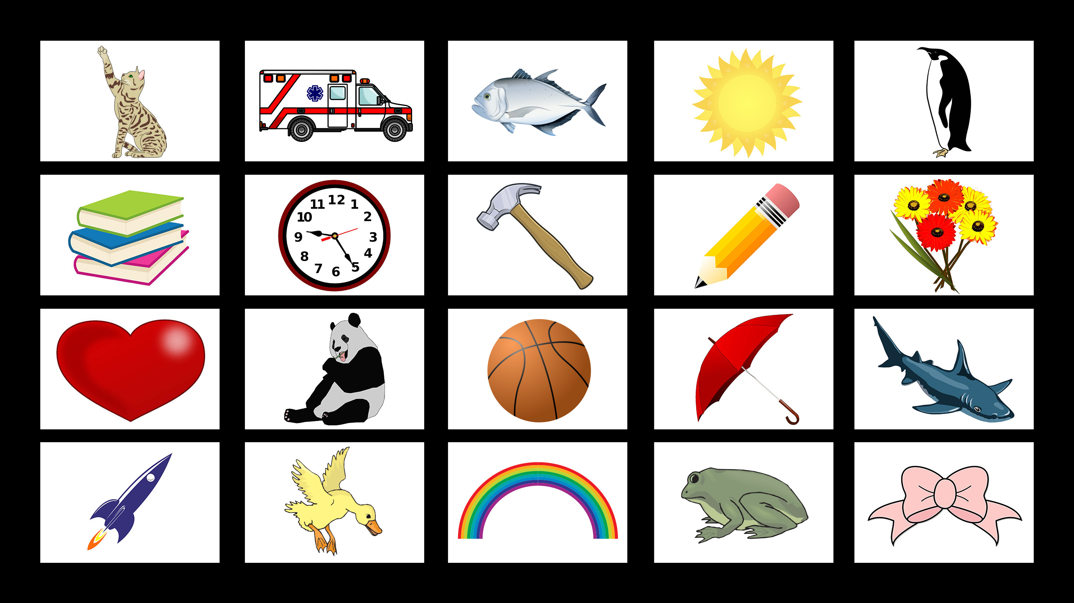
Notes:
K-3 STEM Foundations
Field Test Version: Do not distribute, photocopy or forward this document for use at other locations.
Day 1: Team Building for Scientific Research
Image References
Courtesy of Openclipart.com: Cat, sun, penguin, books, clock, pencil, flowers, heart, panda bear/bear, umbrella shark, rocket, duck, rainbow, frog, bow. https://openclipart.org/
Licensed for use: Ambulance © Oleksandr Bolotov. Basketball © Petr Novotny. Fish © Blueringmedia. Hammer © Dian Permana.
K-3 STEM Foundations. Day 1. Memory Pictures © Baylor College of Medicine.

Slide 3
Notes:
K-3 STEM Foundations
Field Test Version: Do not distribute, photocopy or forward this document for use at other locations.
Day 1: Team Building for Scientific Research
Note(s)
This slide is left purposely blank so that students will not see the first slide containing images until you are ready to project it. See Day 1, “Procedure,” for full instructions.
K-3 STEM Foundations. Day 1. Memory Pictures © Baylor College of Medicine.

Slide 4
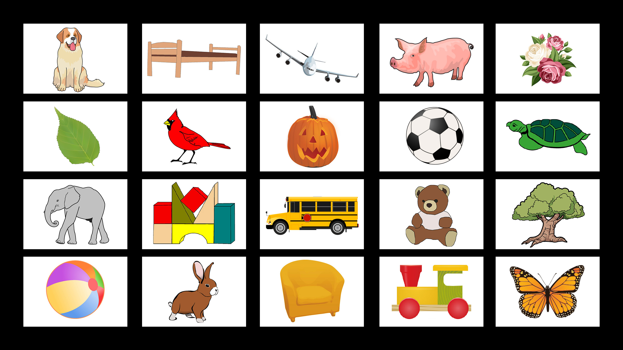
Notes:
K-3 STEM Foundations
Field Test Version: Do not distribute, photocopy or forward this document for use at other locations.
Day 1: Team Building for Scientific Research
Image References
Courtesy of Openclipart.com: Beach ball, bed, blocks, birdl, chair, dog, elephant, jack o’ lantern, teddy bear, rabbit, toy train, tree, turtle. https://openclipart.org/
Licensed for use: Airplane © Andrey Kokidko. Butterfly © Irina Artamonova. Flowers/roses © Nadejda Tchijova. Leaf © Almoond. Pig © Macrovector. School Bus © Denis Dubrovin. Soccer Ball © Petr Novotny.
K-3 STEM Foundations. Day 1. Memory Pictures © Baylor College of Medicine.

Slide 5
Notes:
K-3 STEM Foundations
Field Test Version: Do not distribute, photocopy or forward this document for use at other locations.
Day 1: Team Building for Scientific Research
Note(s)
This slide is left purposely blank so that students will not see the first slide containing images until you are ready to project it. See Day 1, “Procedure,” for full instructions.
K-3 STEM Foundations. Day 1. Memory Pictures © Baylor College of Medicine.

Slide 6
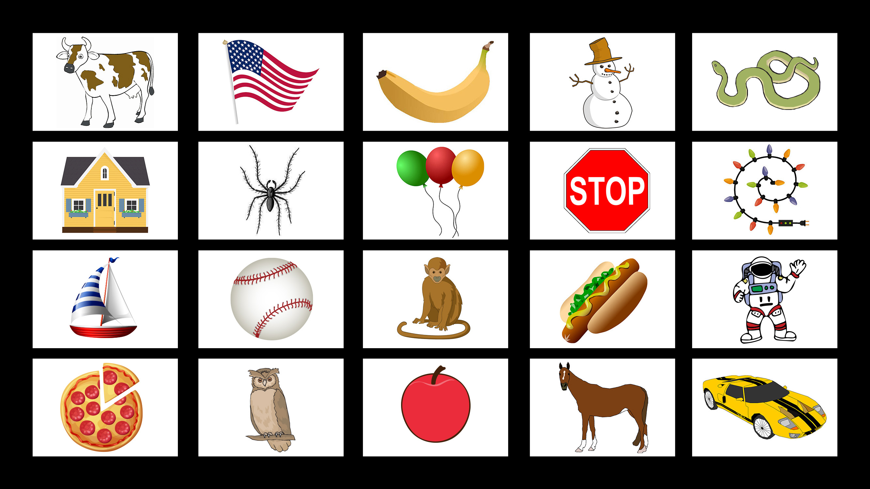
Notes:
K-3 STEM Foundations
Field Test Version: Do not distribute, photocopy or forward this document for use at other locations.
Day 1: Team Building for Scientific Research
Image References
Courtesy of Openclipart.com: Apple, astronaut, balloons, banana, baseball, Christmas lights, cow, flag, horse, hot dog, owl, snake, snowman, spider, sports car, stop sign. https://openclipart.org/
Licensed for use: House © Ksenia Varopaeva. Monkey © Ivan Ryabokon. Pizza © Anna Zasorina. Sailboat © Blueringmedia.
K-3 STEM Foundations. Day 1. Memory Pictures © Baylor College of Medicine.

Slide 7
Notes:
K-3 STEM Foundations
Field Test Version: Do not distribute, photocopy or forward this document for use at other locations.
Day 1: Team Building for Scientific Research
Note(s)
This slide is left purposely blank so that students will not see the first slide containing images until you are ready to project it. See Day 1, “Procedure,” for full instructions.
K-3 STEM Foundations. Day 1. Memory Pictures © Baylor College of Medicine.

